Slide 1
BigTable
Distributed storage for structured data
Fay Chang, Jeffrey Dean, Sanjay Ghemawat, Wilson C. Hsieh, Deborah A. Wallach, Michael Burrows, Tushar Chandra, Andrew Fikes, and Robert Gruber. (2006) Bigtable: A Distributed Storage System for Structured Data. Proceedings of the 7th Symposium on Operating System Design and Implementation (OSDI 2006), pages 205-218.

Slide 2
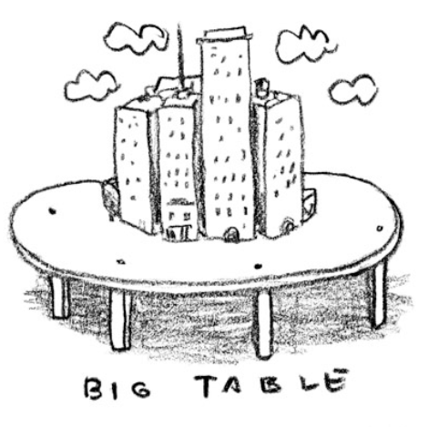
Overview
Goals
scalability
petabytes of data
thousands of machines
applicability
to Google applications
Google Analytics
Google Earth
…
not a general storage model
high performance
high availability
Structure
uses GFS for storage
uses Chubby for coordination
Note: figure from presentation by Jeff Dean (Google)

Slide 3
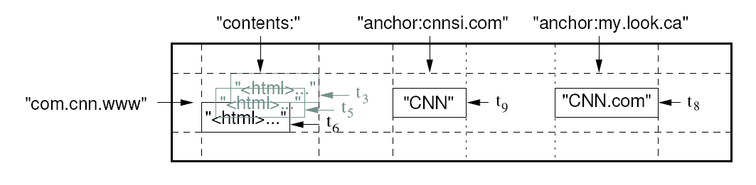
Data Model
(row: string, column: string, timestamp: int64) → string
A BigTable is a sparse, distributed, persistent multidimensional sorted map. The map is indexed by a row key, a column key, and a timestamp; each value in the map is an uninterpreted array of bytes
Row keys
up to 64K, 10-100 bytes typical
lexicographically ordered
reading adjacent row ranges efficient
organized into tablets: row ranges
Column keys
grouped into column families - family:qualifier
column family is basis for access control

Slide 4
Column Families
Column keys are grouped into sets called column families.
A column family must be created before data can be stored in a column key.
Hundreds of static column families.
Syntax is family:key, e.g., Language:English, Language:German, etc.

Slide 5
Timestamps
64 bit integers
Assigned by:
Bigtable: real-time in microseconds,
Client application: when unique timestamps are a necessity.
Items in a cell are stored in decreasing timestamp order.
Application specifies how many versions (n) of data items are maintained in a cell.
Bigtable garbage collects obsolete versions.

Slide 6
Data Model
(row: string, column: string, timestamp: int64) → string
Timestamps
automatically assigned (real-time) or application defined
used in garbage collection (last n, n most recent, since time)
Transactions
iterator-style interface for read operation
atomic single-row updates
no support for multi-row updates
no general relational model

Slide 7
Data Model
Row | Timestamp | Column family: animal: |  | Column family repairs:
 |  | animal:type | animal:size | repairs:cost
enclosure1 | t2 | zebra |  | 1000 EUR
 | t1 | lion | big
enclosure2 | … | … | … | …
We may have a huge number (e.g., hundreds of thousands
or millions) of columns but the column family for each row
will have only a tiny fraction of them populated.
While the number of column families will typically be small in
a table (at most hundreds), the number of columns is unlimited.

Slide 8
Data Model
Column family animal:
(enclosure1, t2, animal:type) | zebra
(enclosure1, t1, animal:size) | big
(enclosure1, t1, animal:type) | lion
Column family repairs:
(enclosure1, t1, repairs:cost) | 1000 EUR

Slide 9
Bigtable
Used in different applications supported by Google.

Slide 10
Application 1: Google Analytics
Enables webmasters to analyze traffic pattern at their web sites. Statistics such as:
Number of unique visitors per day and the page views per URL per day,
Percentage of users that made a purchase given that they earlier viewed a specific page.
How?
A small JavaScript program that the webmaster embeds in their web pages.
Every time the page is visited, the program is executed.
Program records the following information about each request:
User identifier
The page being fetched

Slide 11
Application 1: Google Analytics (Cont…)
Two of the Bigtables
Raw click table (~ 200 TB)
A row for each end-user session.
Row name include website’s name and the time at which the session was created.
Clustering of sessions that visit the same web site. And a sorted chronological order.
Compression factor of 6-7.
Summary table (~ 20 TB)
Stores predefined summaries for each web site.
Generated from the raw click table by periodically scheduled MapReduce jobs.
Each MapReduce job extracts recent session data from the raw click table.
Row name includes website’s name and the column family is the aggregate summaries.
Compression factor is 2-3.

Slide 12
Application 2: Google Earth & Maps
Functionality: Pan, view, and annotate satellite imagery at different resolution levels.
One Bigtable stores raw imagery (~ 70 TB):
Row name is a geographic segments. Names are chosen to ensure adjacent geographic segments are clustered together.
Column family maintains sources of data for each segment.
There are different sets of tables for serving client data, e.g., index table.

Slide 13
Application 3: Personalized Search
Records user queries and clicks across Google properties.
Users browse their search histories and request for personalized search results based on their historical usage patterns.
One Bigtable:
Row name is userid
A column family is reserved for each action type, e.g., web queries, clicks.
User profiles are generated using MapReduce.
These profiles personalize live search results.
Replicated geographically to reduce latency and increase availability.

Slide 14
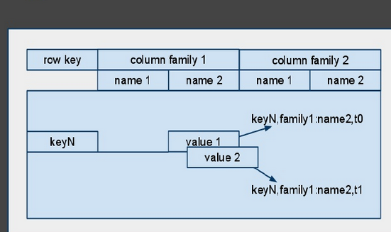
Data Model

Slide 15
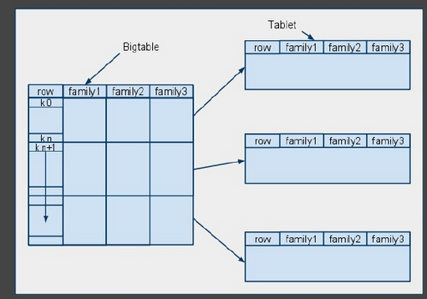
Data Model

Slide 16
Table implementation
a
...
f
g
...
k
...
v
...
z
table
a
...
f
tablet
g
...
k
tablet
v
...
z
tablet
a table is divided into a set of tablets, each storing a set of consecutive rows
tablets typically 100-200MB

Slide 17
Table implementation
g
...
k
tablet
SSTable
SSTable
. . .
SSTable
a tablet is stored as a set of SSTables
an SSTable has a set of 64K blocks and an index
each SSTable is a GFS file
64K
Block
64K
Block
64K
Block
SSTable
...
index

Slide 18
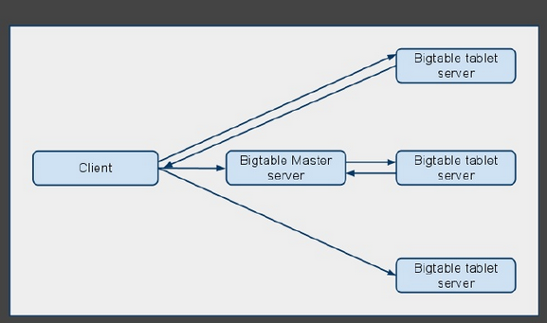
Table Implementation

Slide 19
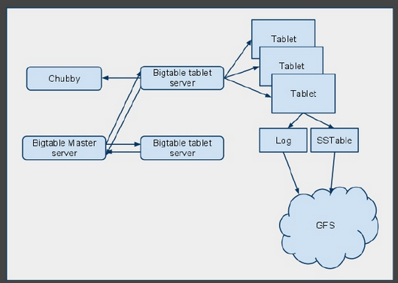
Implementation

Slide 20
APIs
Metadata operations
Create/delete tables, column families, change metadata
Writes
Set(): write cells in a row
DeleteCells(): delete cells in a row
DeleteRow(): delete all cells in a row
Reads
Scanner: read arbitrary cells in a bigtable
Each row read is atomic
Can restrict returned rows to a particular range
Can ask for just data from 1 row, all rows, etc.
Can ask for all columns, just certain column families, or specific columns

Slide 21
Building Blocks
Google File System (GFS)
stores persistent data (SSTable file format)
Scheduler
schedules jobs onto machines
Chubby
Lock service: distributed lock manager
master election, location bootstrapping
MapReduce (optional)
Data processing
Read/write Bigtable data

Slide 22
Implementation
Single-master distributed system
Three major components
Library that linked into every client
One master server
Assigning tablets to tablet servers
Detecting addition and expiration of tablet servers
Balancing tablet-server load
Garbage collection
Metadata Operations
Many tablet servers
Tablet servers handle read and write requests to its table
Splits tablets that have grown too large

Slide 23
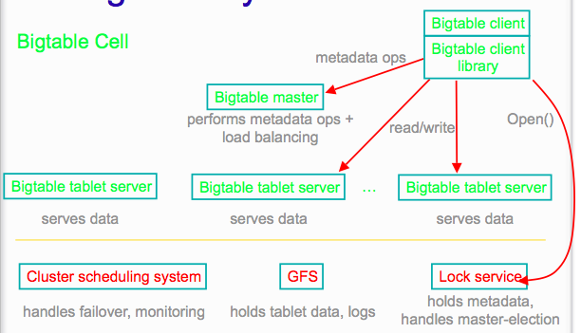
Implementation
Notes:
Client data doesn’t move through master server. Clients communicate directly with tablet servers for reads and writes.
Most clients never communicate with the master server, leaving it lightly loaded in practice.

Slide 24
Chubby
A persistent and distributed lock service.
Consists of 5 active replicas, one replica is the master and serves requests.
Service is functional when majority of the replicas are running and in communication with one another – when there is a quorum.
Implements a nameservice that consists of directories and files.

Slide 25
Software Infrastructure
A Bigtable library linked to every client.
Many tablet servers.
Tablet servers are added and removed dynamically.
Ten to a thousand tablets assigned to a tablet server.
Each tablet is typically 100-200 MB in size.
One master server responsible for:
Assigning tablets to tablet servers,
Detecting the addition and deletion of tablet servers,
Balancing tablet-server load,
Garbage collection of files in GFS.
Client communicates directly with tablet server for reads/writes.

Slide 26
BigTable & GFS
BigTable is built on GFS, which it uses as a backing store both log and data files.
GFS provides reliable storage for SSTables, which are used to persist table data.
SSTables store data as a simple key->value map which can be looked up with a single disk access by searching an index (which is stored at the end of the SSTable) and then doing a read from the indexed location.
Alternatively, SSTables can be completely memory-mapped which avoids the disk read.

Slide 27
Finding Tablets
The location of a root tablet, which contains metadata for a BigTable instance, is located in Chubby and can be read from the filesystem there.
The root tablet contains the locations of other metadata tablets, which themselves point to the location of data tablets.
Together the root and metadata tablets form the METADATA table, which is itself a BigTable table.
Each row in the METADATA table maps the pair (table name, last row) to a location for a tablet whose last row is as given.

Slide 28
Location of Tablets (Ranges)
3 Level-B+ tree
1st Level: A file stored in chubby contains location of the root tablet, i.e., a directory of ranges (tablets) and associated meta-data.
The root tablet never splits.
2nd Level: Each meta-data tablet contains the location of a set of user tablets.
3rd Level: A set of SSTable identifiers for each tablet.
Since this three-level lookup requires a lot of network round trips, clients cache the location of tablets.
If a cached location is no longer valid, the client can go back to the network. To save yet further on round-trips, locations are speculatively pre-fetched by piggy-backing them on real location queries.

Slide 29
Placement of Tablets
A tablet is assigned to one tablet server at a time.
Master maintains:
The set of live tablet servers,
Current assignment of tablets to tablet servers (including the unassigned ones)
Chubby maintains tablet servers:
A tablet server creates and acquires an eXclusive lock on a uniquely named file in a specific chubby directory (named server directory),
Master monitors server directory to discover tablet server,
A tablet server stops processing requests if it loses its X lock (network partitioning).
Tablet server will try to obtain an X lock on its uniqely named file as long as it exists.
If the uniquely named file of a tablet server no longer exists then the tablet server kills itself. Goes back to a free pool to be assigned tablets by the master.

Slide 30
Placement of Tablets
Master detects when a tablet server is in the free pool.
How? Master periodically probes each tablet server for the status of its lock.

Slide 31
Master
Should the Master die, a new Master is initiated. The master executes the following steps:

Slide 32
Client Write & Read Operations
Write operation arrives at a tablet server:
Server ensures the client has sufficient privileges for the write operation (Chubby),
A log record is generated to the commit log file,
Once the write commits, its contents are inserted into the memtable.
Read operation arrives at a tablet server:
Server ensures client has sufficient privileges for the read operation (Chubby),
Read is performed on a merged view of (a) the SSTables that constitute the tablet, and (b) the memtable.

Slide 33
Tablet operations
Write Op
memtable
Read Op
Memory
GFS
tablet (commit) log
SSTable
SSTable
SSTable
Updates are written in a memory table after being recorded in a log
Reads combine information in the memtable with that in the SSTables

Slide 34
Refinement – Locality groups & Compression
Locality Groups
Can group multiple column families into a locality group
Separate SSTable is created for each locality group in each tablet.
Segregating columns families that are not typically accessed together enables more efficient reads.
In WebTable, page metadata can be in one group and contents of the page in another group.

Slide 35
Write Operations
As writes execute, size of memtable increases.
Once memtable reaches a threshold:
Memtable is frozen,
A new memtable is created,
Frozen metable is converted to an SSTable and written to GFS.
This minimizes memory usage of tablet server, and reduces recovery time in the presence of crashes (checkpoints).
(in the background) reads a few SSTables and memtable to produce one SSTable. (Input SSTables and memtable are discarded.)
rewrites all SSTables into exactly one SSTable (containing no deletion entries).

Slide 36
Compactions
Minor compaction
Converts the memtable into an SSTable
Reduces memory usage and log traffic on restart
Merging compaction
Reads the contents of a few SSTables and the memtable, and writes out a new SSTable
Reduces number of SSTables
Major compaction
Merging compaction that results in only one SSTable
No deletion records, only live data

Slide 37
Minor compaction
new
memtable
old
memtable
Memory
GFS
tablet (commit) log
SSTable
SSTable
SSTable
SSTable
Triggered when memtable reaches a threshold
Reduces memory footprint
Reduces data read from commit log on recovery from failure
Read/write operations continue during compaction

Slide 38
Merging compaction
new
memtable
old
memtable
Memory
GFS
tablet (commit) log
SSTable
SSTable
SSTable
SSTable
SSTable
Compacts existing memtable and some number of SSTables into a single new SSTable
Used to control number of SSTables that must be scanned to perform operations
Old memtable and SSTables are discarded at end of compaction

Slide 39
Major compaction
new
memtable
old
memtable
Memory
GFS
tablet (commit) log
SSTable
SSTable
SSTable
SSTable
SSTable
Compacts existing memtable and all SSTables into a single SSTable

